Slide 1
ABSTRACT
Purpose. To investigate why infantile nystagmus syndrome (INS) patients often complain that they are “slow to see.” Static measures of visual function (e.g., visual acuities) do not measure normal dynamic demands on visual function. Time-sensitive measures are required to more fully measure and understand visual function. We investigated the dynamic properties of INS on saccadic latency (Ls) and target acquisition time (Lt)—new aspects of visual function. Our behavioral ocular motor system (OMS) model predicted stimulus-based effects on target acquisition time in INS. Measurements of the dynamics of INS foveation in patient responses to changes in target position were used to evaluate both the patient complaint and model predictions.
Methods. We used the responses of 4 INS subjects with different INS waveforms to test the model’s predictions. Infrared reflection was used for 1 INS subject, high-speed digital video for 3. We analyzed human responses to large and small target-step stimuli. We evaluated: time within the cycle (Tc), normalized Tc (Tc%), initial orbital position (Po), saccade amplitude, initial retinal error (ei), and final retinal error (ef). Ocular motor simulations were performed in MATLAB Simulink and the analysis was performed in MATLAB using OMLAB software.
Results. Ls was a fixed value that was typically higher than normal. For Lt, Tc% was the most influential factor for each waveform type. Model outputs accurately simulated human data. Refixation strategies depended on the size of the required position change and used slow and fast nystagmus phases, catch-up saccades, or combinations of them. These strategies allowed effective foveation after target movement, sometimes producing increased Lt.
Conclusions. Saccades disrupt the OMS’ ability to accurately calculate saccade amplitude and refoveate. Idiosyncratic variations in Ls occur among INS subjects. OMS model simulations demonstrated this emergent behavior; this robust model can be used to predict and reinforce data analysis in future research.
Nothing to Disclose
Notes:
ARVO Poster

Slide 2
T&R PROCEDURE
Discovery-Hypothesis-Demonstration-Trial-INS&AN Therapy
1978: Secondary effects of Kestenbaum surgery discovered
1979: Secondary effects of Kestenbaum surgery reported
1979: T&R surgery hypothesized
1992: Achiasmatic Belgian sheepdog model of INS found
1998: Horizontal T&R procedure demonstrated on sheepdog
1998: Vertical T&R procedure demonstrated on sheepdog
1999: Positive T&R procedure results in INS and SSN reported
1999: Proprioceptive hypothesis for T&R procedure advanced
2000: NEI sponsored masked-data clinical trial begun
2002: Proprioceptive hypothesis for T&R procedure supported
2003: Positive phase-1 (10 adults) clinical trial results reported
2003: First attempted T&R procedure for APN
2004: Positive phase-2 (5 children) clinical trial results reported
2004: Positive T&R procedure results in APN reported
2005: Demonstration that T&R procedure affects only small signals
2005: Demonstration that T&R procedure broadens the null region
2006: Positive T&R procedure results in acquired DBN reported
Notes:
The interval (1979-1992) between the hypothesis and its testing was due to the difficulty in locating an animal model for INS.

Slide 3
BACKGROUND
T&R has been reported to increase visual acuities of patients with infantile nystagmus syndrome (INS), asymmetric, (a)periodic alternating nystagmus (APAN), acquired pendular (APN) and downbeat (DPN) nystagmus, and to reduce oscillopsia in the latter two.
The broadening of the NAFX peak post-therapy demonstrated the need to assess pre-therapy waveform quality and visual acuity at different gaze angles.
INS patients complain that they are “slow to see.”
Notes:
This study and others that are currently under way.

Slide 4

QUESTIONS
What causes the variable impression of being “slow to see?”
Does INS lengthen saccadic reaction time?
Does INS lengthen target acquisition time?
If any of the above are true, what target criteria affect the changes and by what mechanism(s)?
Is there a dynamic measure of visual function that should be assessed in INS?
Notes:
The neural substrate is present in the EOM “tendons” as is evidence for a slow-acting (non-stretch reflex) proprioceptive loop.

Slide 5
HYPOTHESES
Small saccadic latency increases are not the cause of the “slow-to-see” phenomenon.
The timing of the target jump within an INS cycle will adversely affect the total target acquisition time.
Notes:
The neural substrate is present in the EOM “tendons” as is evidence for a slow-acting (non-stretch reflex) proprioceptive loop.

Slide 6
METHODS
Ocular motor simulations using a behavioral OMS model were performed in MATLAB Simulink and the saccadic latency analysis was performed in MATLAB using “OMtools” software.
High-speed digital video and infrared reflection systems were used to measure the eye movements (fixation and saccades) of four patients with INS.
Eye movement data were calibrated and analyzed for the fixating eye. Stimulus timing, orbital position, and retinal errors were examined.
Notes:
The NAFX is an objective, sensitive measure of the direct waveform changes of EOM surgery.
Other, more global measures of eye movements are insensitive to the important foveation changes that affect acuity directly.
Recent attempts to use either wavelet analysis or dynamical systems analysis failed to detect the waveform improvements of tenotomy in INS demonstrated by the NAFX and resulting in improved VA.

Slide 7
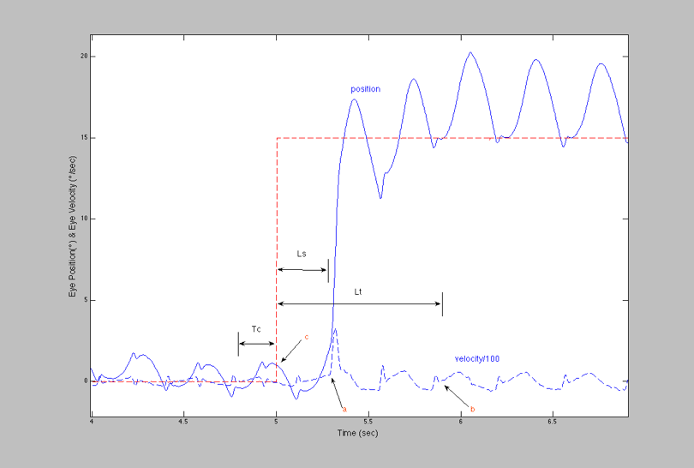
METHODS
Ls - Saccadic Latency
Lt - Target Acquisition Time
Tc - Stimulus Time in INS Cycle
Notes:
The NAFX is an objective, sensitive measure of the direct waveform changes of EOM surgery.
Other, more global measures of eye movements are insensitive to the important foveation changes that affect acuity directly.
Recent attempts to use either wavelet analysis or dynamical systems analysis failed to detect the waveform improvements of tenotomy in INS demonstrated by the NAFX and resulting in improved VA.

Slide 8
OCULAR MOTOR SYSTEM MODEL
INS Model Block Diagram
2004, Jacobs et al.

Slide 9
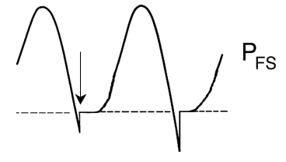
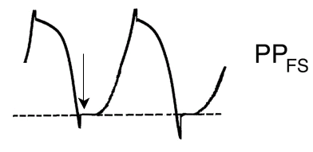
MODEL PREDICTIONS
Notes:
The foveal areas are shown for the fixating eyes.
Note the downbeat nystagmus has little or no horizontal component.

Slide 10
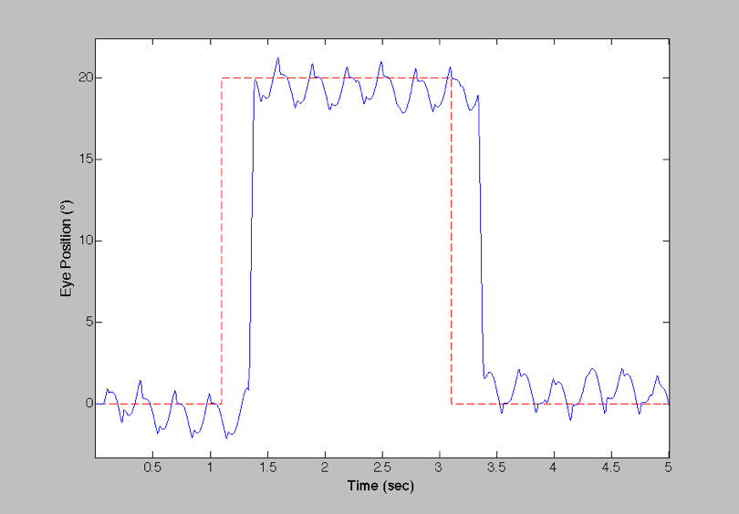
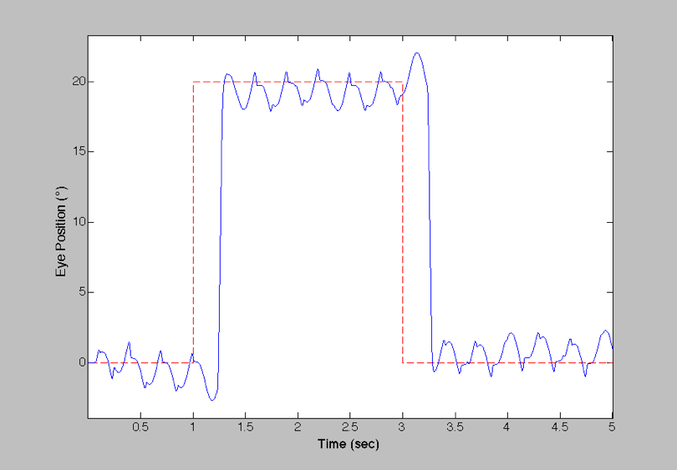
MODEL PREDICTIONS
Different Target Timings
Lt=510ms
Lt=620ms
Lt=460ms
Lt=570ms
Counter-intuitive?
Target jumps during “still” foveation periods have longer target acquisition time
It’s the intrinsic saccades that matter!!
Notes:
The foveal areas are shown for the fixating eyes.
Note the downbeat nystagmus has little or no horizontal component.

Slide 11
RESULTS
Saccadic Latencies
Normal Saccadic Latency
}
Notes:
The foveal areas are shown for the fixating eyes.
Note the downbeat nystagmus has little or no horizontal component.

Slide 12
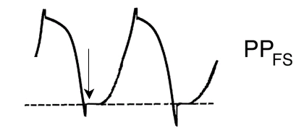
RESULTS
Target Acquisition Times
Large Steps
Notes:
The foveal areas are shown for the fixating eyes.
Note the downbeat nystagmus has little or no horizontal component.

Slide 13
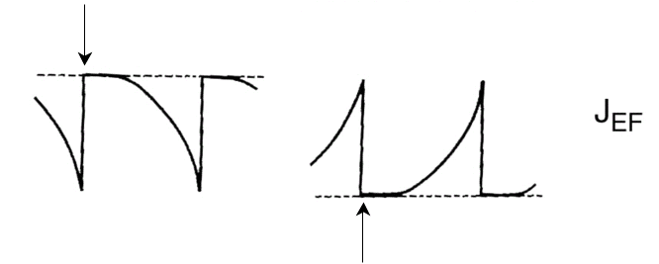
RESULTS
Target Acquisition Times
Large Steps
Notes:
The foveal areas are shown for the fixating eyes.
Note the downbeat nystagmus has little or no horizontal component.

Slide 14
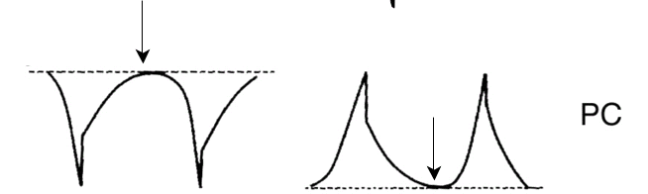
RESULTS
Target Acquisition Times
Large Steps
Notes:
The foveal areas are shown for the fixating eyes.
Note the downbeat nystagmus has little or no horizontal component.

Slide 15
RESULTS
Target Acquisition Times
Small Steps
Notes:
The foveal areas are shown for the fixating eyes.
Note the downbeat nystagmus has little or no horizontal component.

Slide 16
RESULTS
Target Acquisition Times
Small Steps
(Same results for large steps)
Notes:
The foveal areas are shown for the fixating eyes.
Note the downbeat nystagmus has little or no horizontal component.

Slide 17
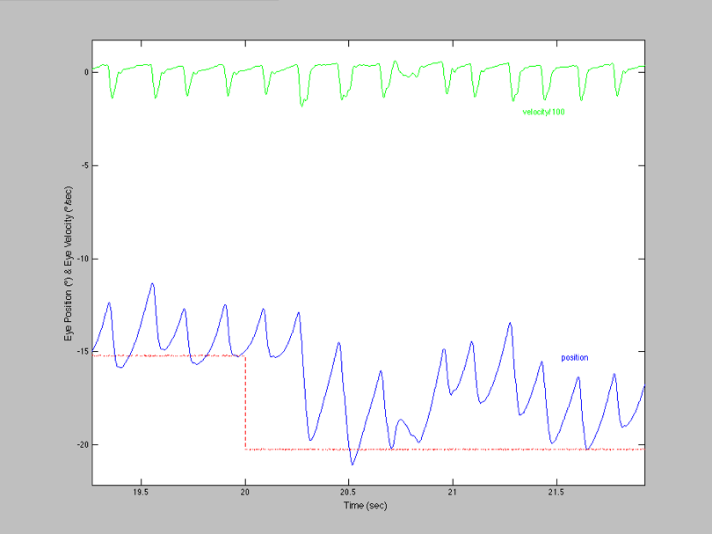
RESULTS
Foveating Strategy
Small Steps
Preprogrammed Fast Phase
Refixation Saccade
Lt~600ms
Notes:
The foveal areas are shown for the fixating eyes.
Note the downbeat nystagmus has little or no horizontal component.

Slide 18
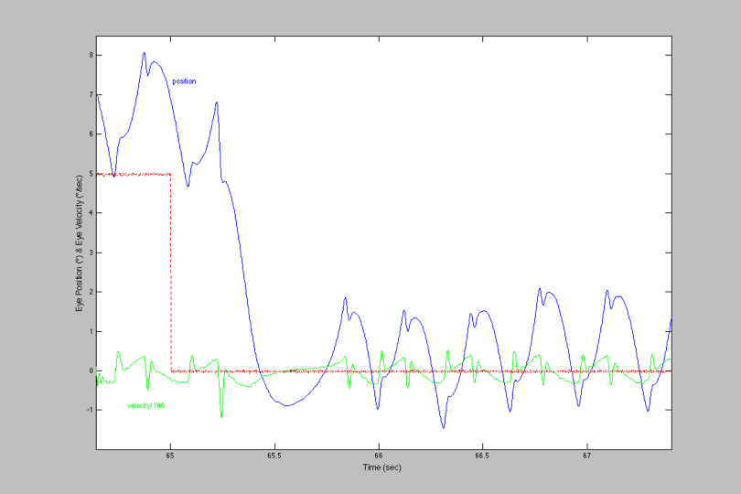
RESULTS
Foveating Strategy
Inaccurate Saccade
Small Steps
Small Steps
Riding Slow Phase
Lt=1.1s
Notes:
The foveal areas are shown for the fixating eyes.
Note the downbeat nystagmus has little or no horizontal component.

Slide 19
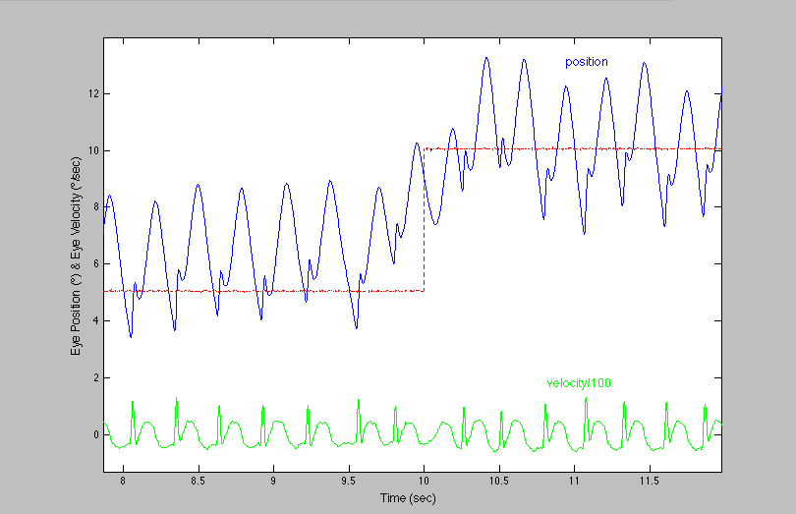
RESULTS
Foveating Strategy
Anticipation
Small Steps
Notes:
The foveal areas are shown for the fixating eyes.
Note the downbeat nystagmus has little or no horizontal component.

Slide 20
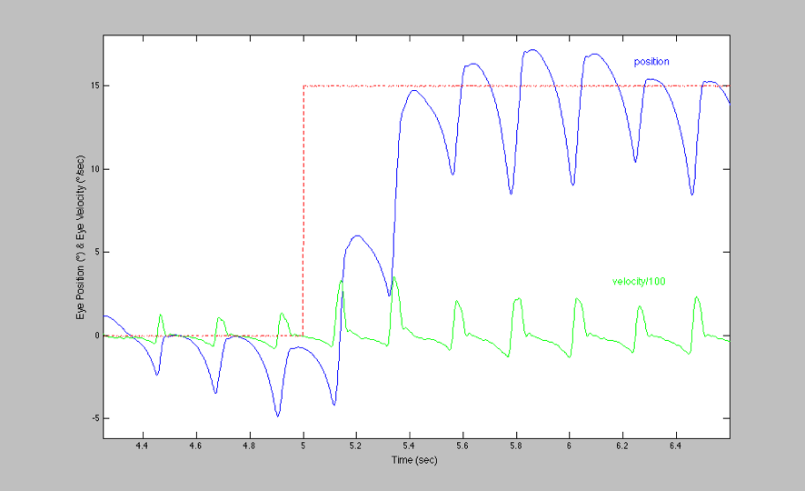
RESULTS
Foveating Strategy
Lt~600ms
Refixation Saccade
Altered Fast Phase
Large Steps
Notes:
The foveal areas are shown for the fixating eyes.
Note the downbeat nystagmus has little or no horizontal component.

Slide 21
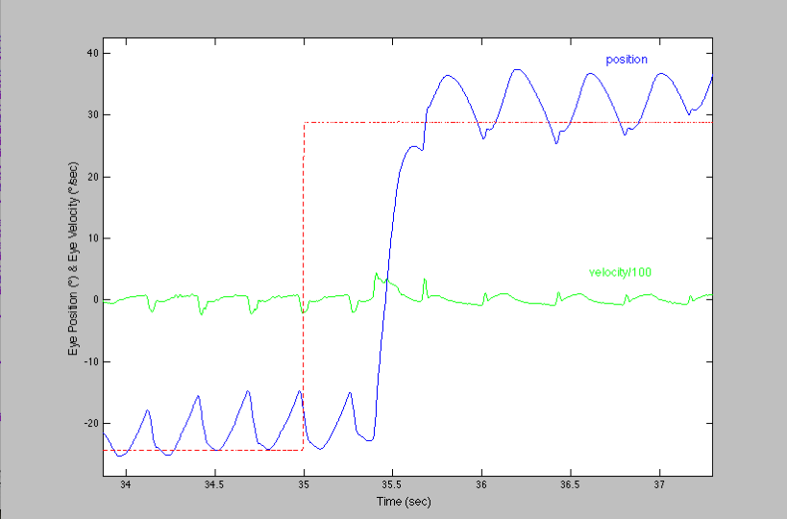
RESULTS
Foveating Strategy
Lt=1s
Waveform Change
Corrective Saccade
Large Steps
Hypometric Saccade
Notes:
The foveal areas are shown for the fixating eyes.
Note the downbeat nystagmus has little or no horizontal component.

Slide 22
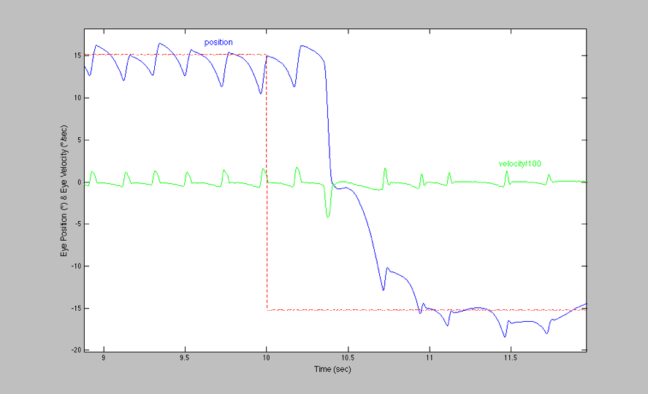
RESULTS
Foveating Strategy
Hypometric Saccade
Large Steps
Riding Slow Phase
Lt=1s
Notes:
The foveal areas are shown for the fixating eyes.
Note the downbeat nystagmus has little or no horizontal component.

Slide 23
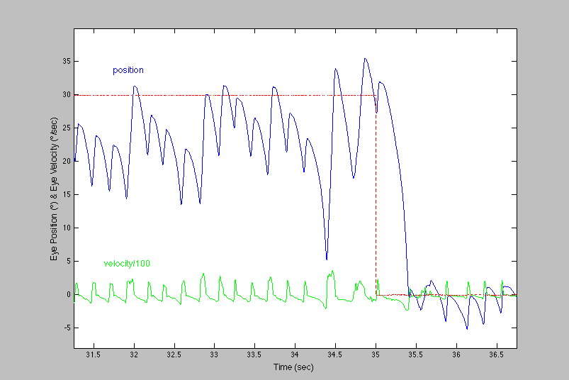
RESULTS
Foveating Strategy
Impaired Gaze Holding
Riding Slow Phase
Large Steps
Lt=900ms
Notes:
The foveal areas are shown for the fixating eyes.
Note the downbeat nystagmus has little or no horizontal component.

Slide 24
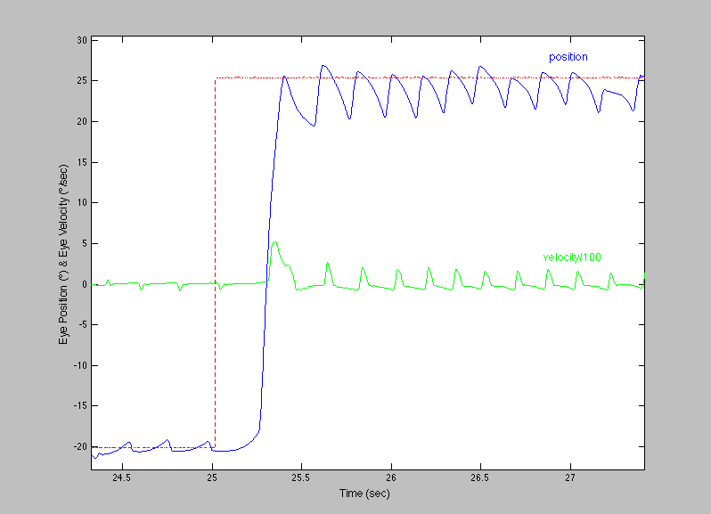
RESULTS
Foveating Strategy
Direction Change
Lt~800ms
Pulse-Step Mismatch
Large Steps
Notes:
The foveal areas are shown for the fixating eyes.
Note the downbeat nystagmus has little or no horizontal component.

Slide 25
CONCLUSIONS
Although saccadic latency appears somewhat lengthened in INS, the amount is insufficient to cause the “slow-to-see” impression.
The variable “slow-to-see” impression is caused by the interaction of the time of a target jump and the intrinsic saccades generated as part of INS waveforms.
Target jumps occurring near intrinsic saccades result in inaccurate saccades and lengthen the total target acquisition time far beyond saccadic latencies and result in the real phenomenon of being “slow-to-see”.

Slide 26
CONCLUSIONS
The Behavioral OMS Model:
  1. Accurately predicted increases in total target acquisition time in the presence of INS waveforms.
  2. Demonstrated that it was the interaction between intrinsic waveform saccades and the required voluntary refixation saccade that resulted in the increased target acquisition time.

Slide 27
CONCLUSIONS
Static measures of visual function (i.e., primary-position and lateral gaze visual acuity measurements) are insufficient measures of important visual function variables like target acquisition time.
Individuals with INS should also be tested for target acquisition time as part of their visual function assessment.

